Slide 1
AEC services to support people with a disability
David Lang
Assistant Commissioner, Information Technology
Australian Electoral Commission

Slide 2




Disability advisory committee
National Council on Intellectual Disability

Slide 3
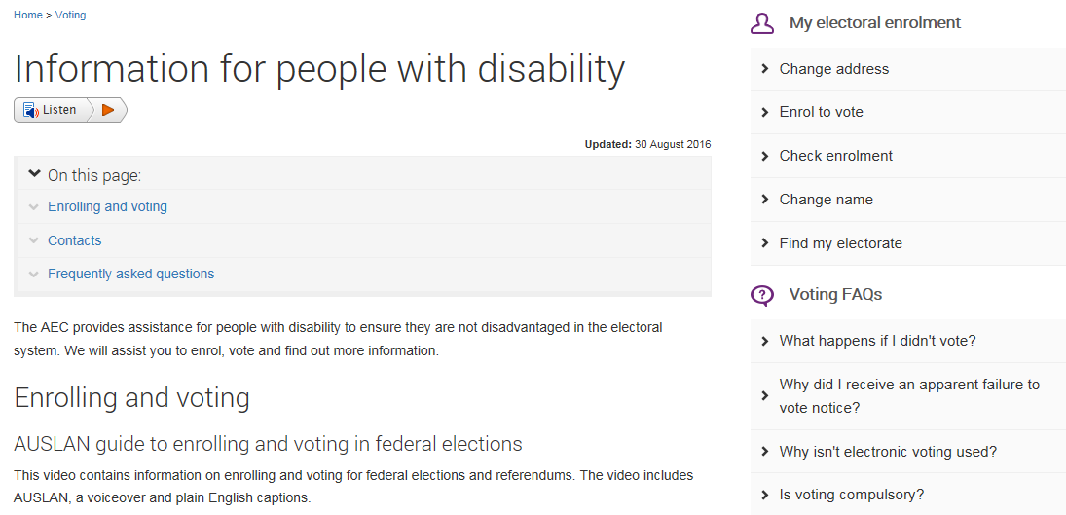
AEC website

Slide 4
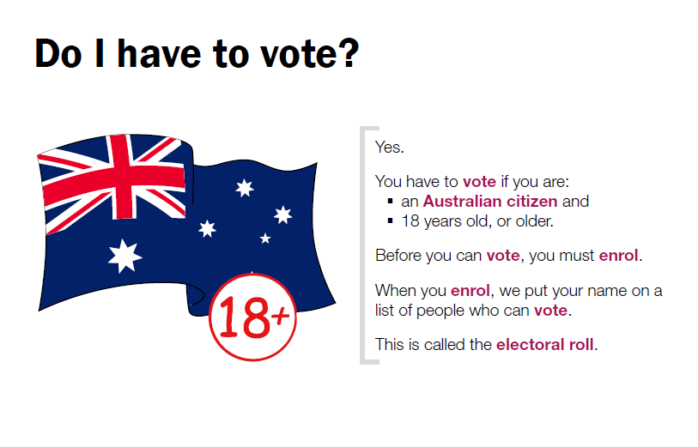
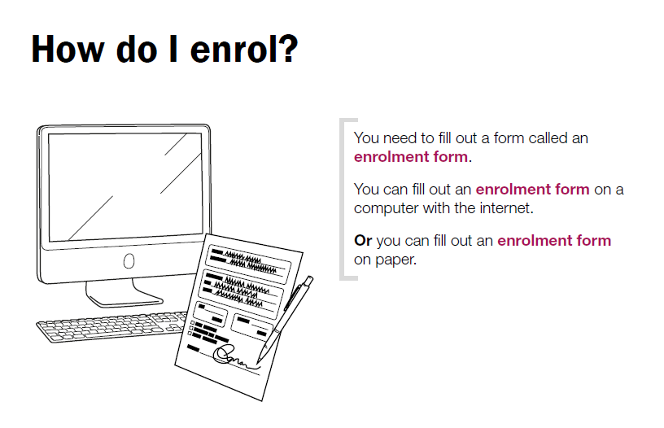
Plain English guides are available on enrolment, voting at a polling place and voting by mail.

Slide 5
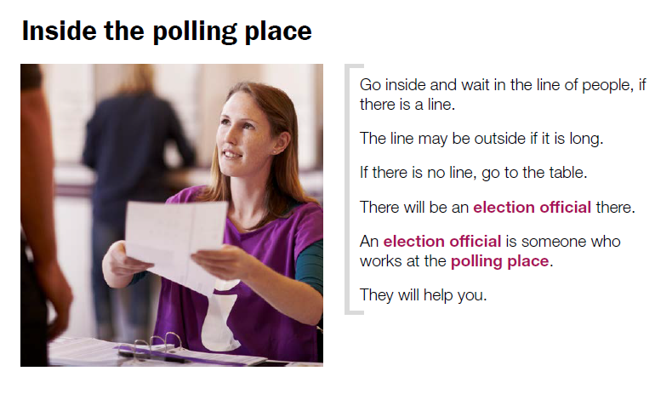
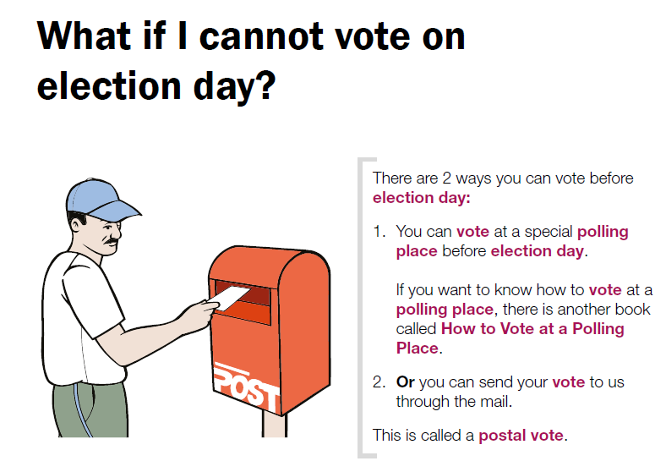
Plain English Guides

Slide 6
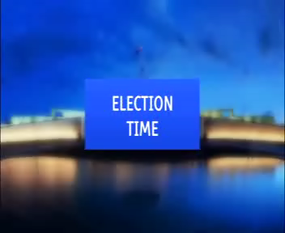
AUSLAN Guide

Slide 7
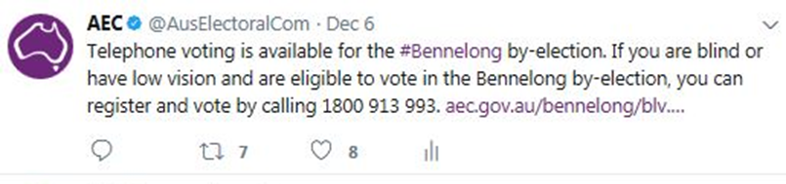
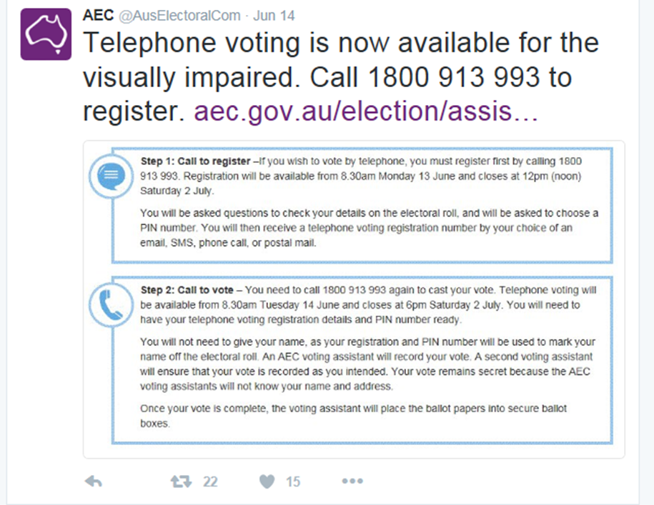
Blind and Low Vision Voting

Slide 8
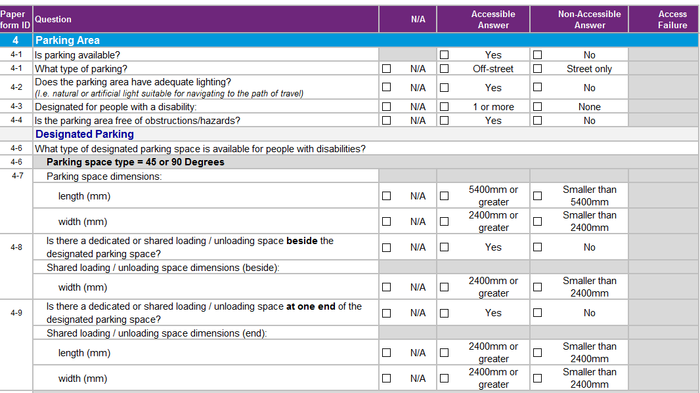
Polling Place Accessibility

Slide 9
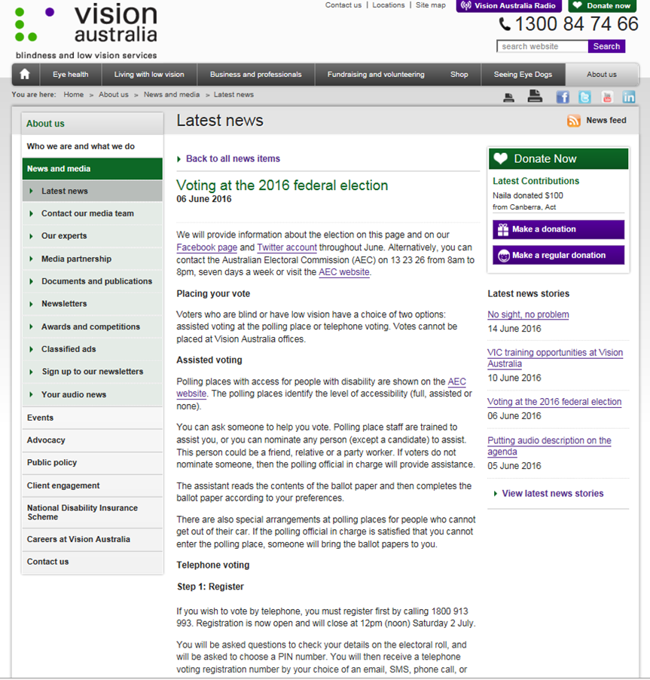
Disability sector stakeholders
Ongoing Partnership with Vision Australia

